Slide 1


SOFA Fashion Social Network
SOFA Team – Spring 2021
Hanoi, May 7th , 2021

Slide 2
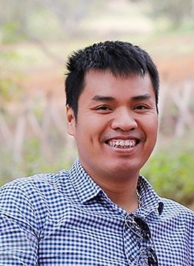
Phạm Ngọc Hà
Supervisor

Slide 3
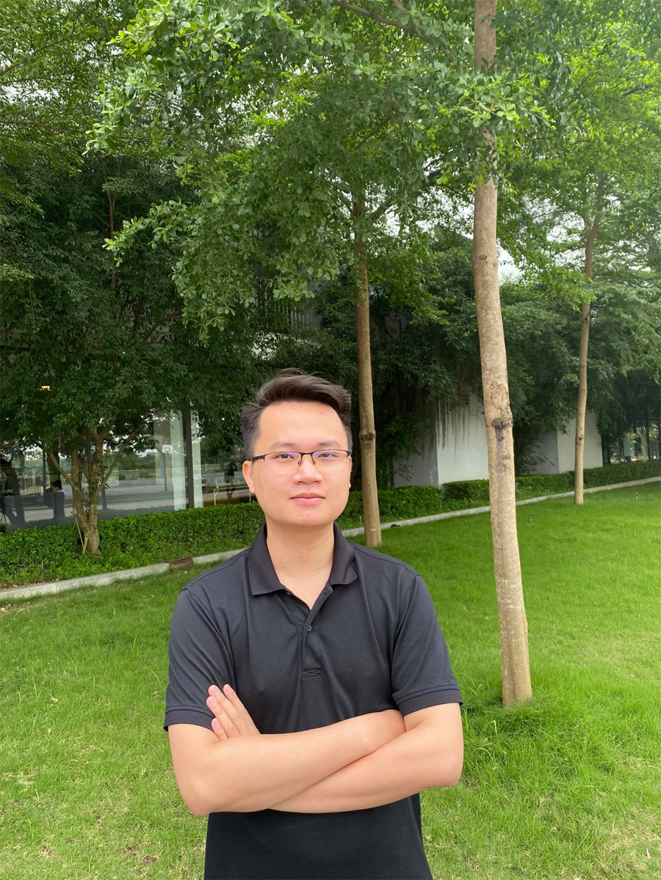

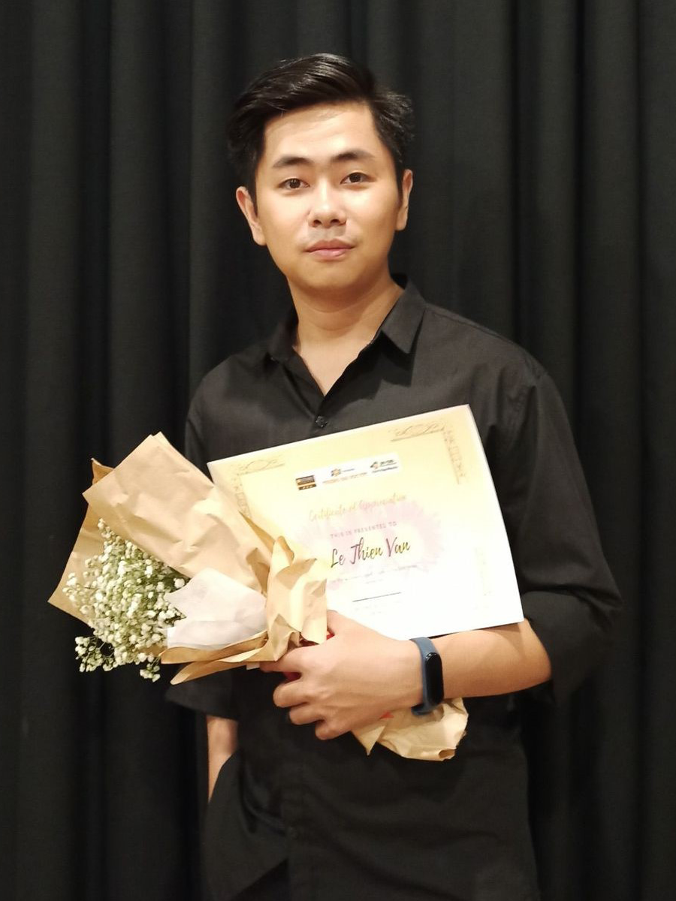
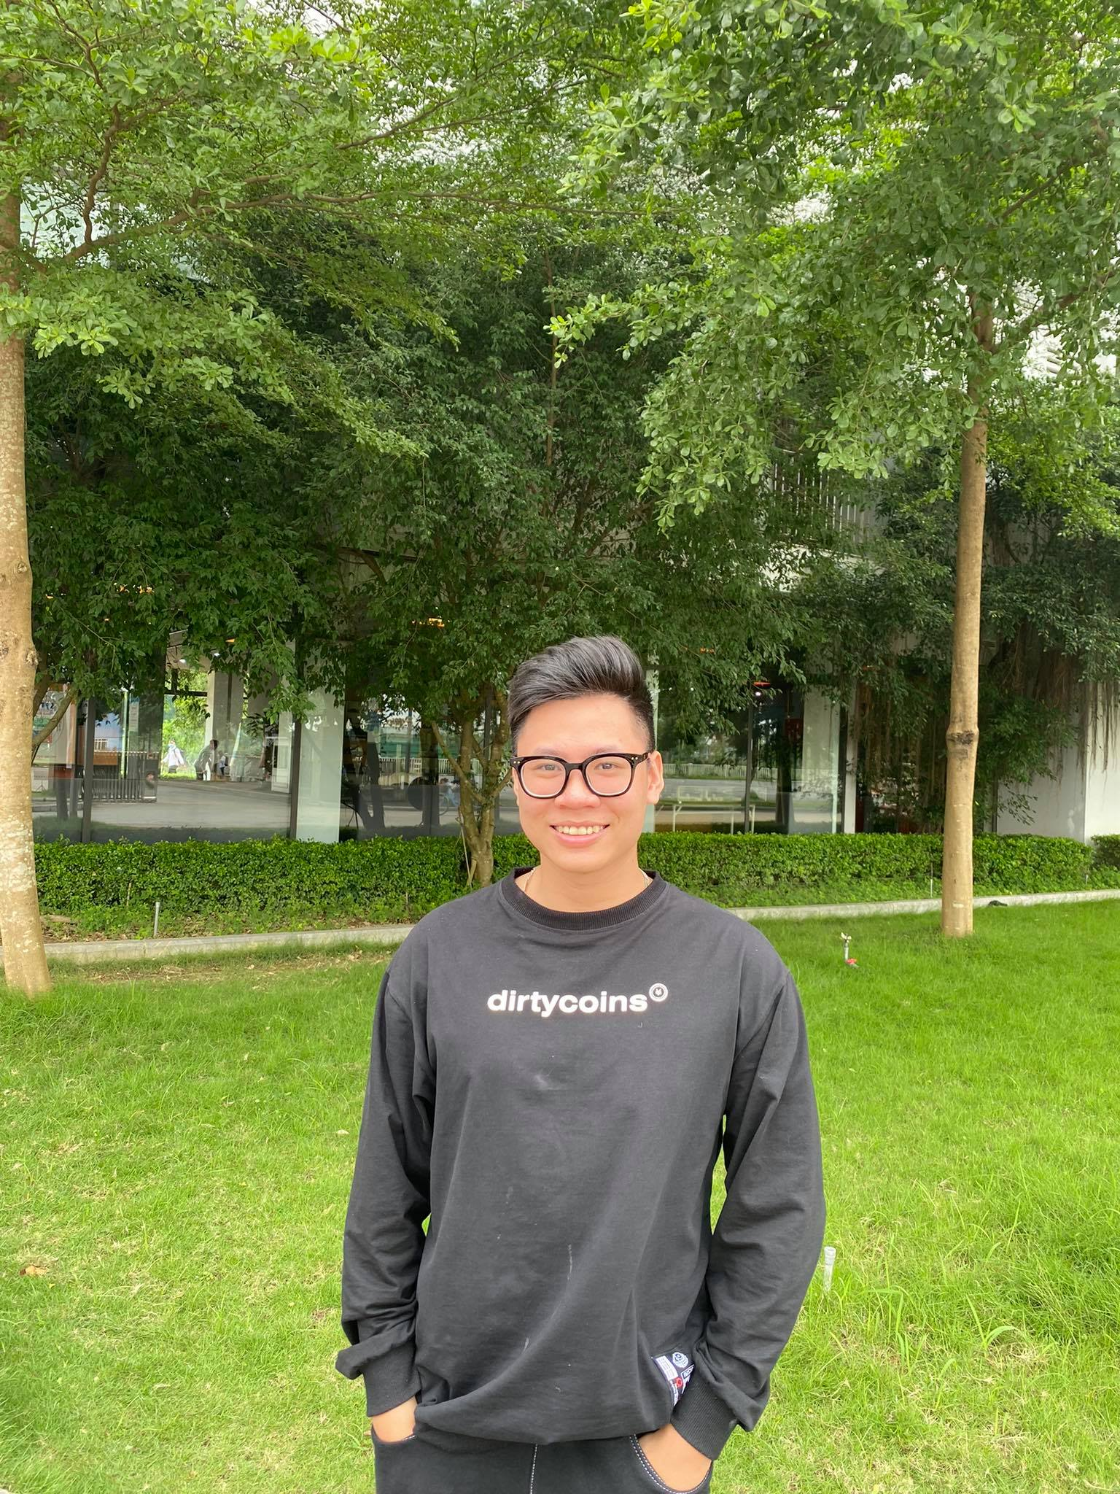
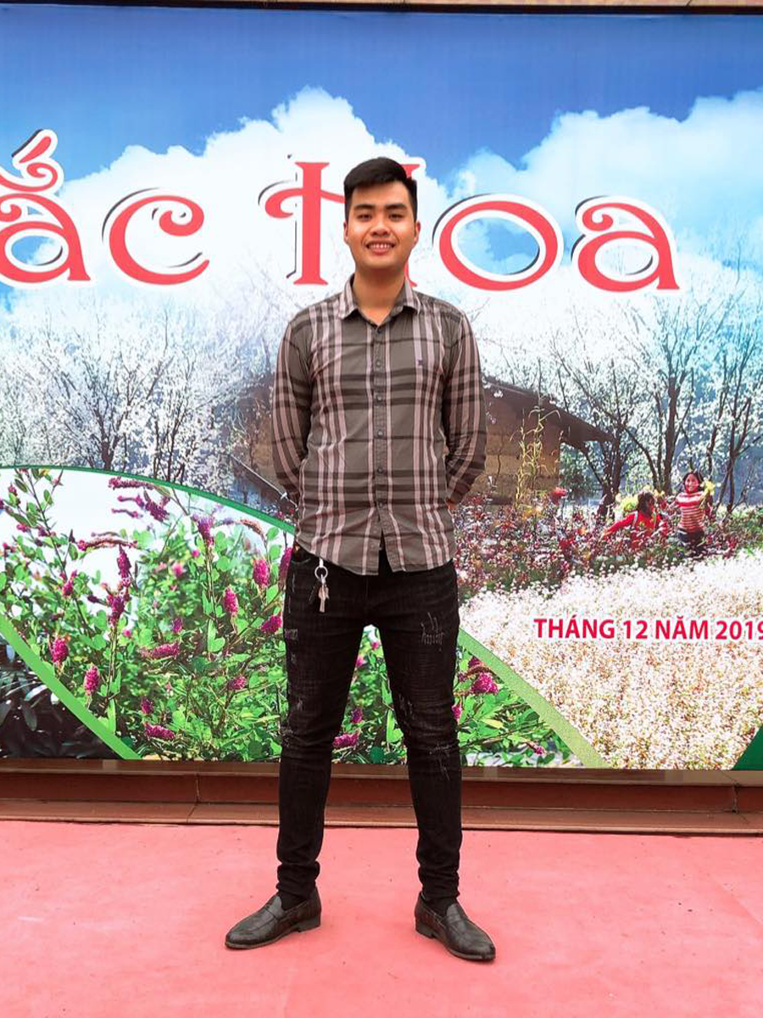
SoFa
Nguyễn Thanh Tùng
Team
Nguyễn Huy Hoàng
Lê Thiện Văn
Hà Việt Dũng
Mai Văn Viên
Developer
Developer
Project manager
Developer
Developer

Slide 4

Agenda
Introduction
03.
01.
02.
Software Requirement Specification
Project management plan
Software Design
Testing
04.
05.
Demo – Q & A
06.

Slide 5

01.
Introduction

Slide 6

Goals
PROJECT INFORMATION
BACKGROUND
EXISTING SYSTEMS
PROPOSAL SYSTEM
Project name, team members
Reasons make us came up with this idea
Review of existing systems
System function, work flows, tool and techniques

Slide 7
Project information
Project name: SOFA – Fashion Social Network Project code: SOFA Project group name: SOFA Team Product type: Web and Mobile application
Timeline: From 4th January 2021 to 28th April 2021

Slide 8
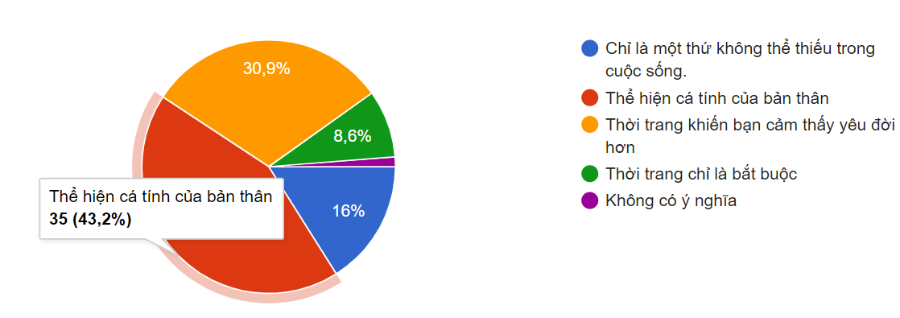
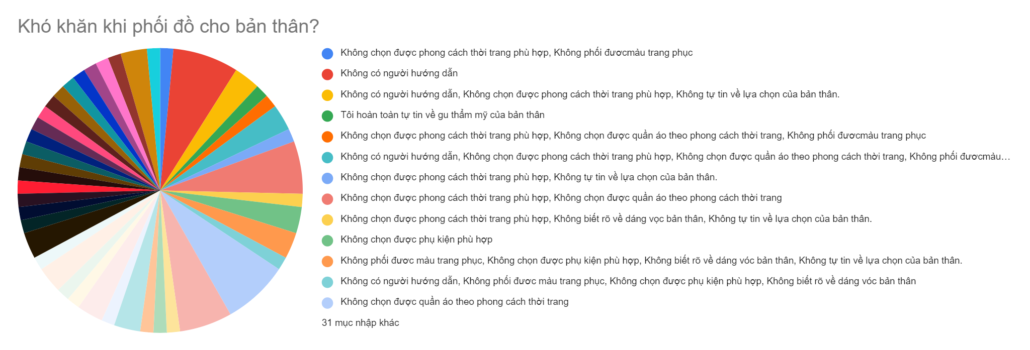
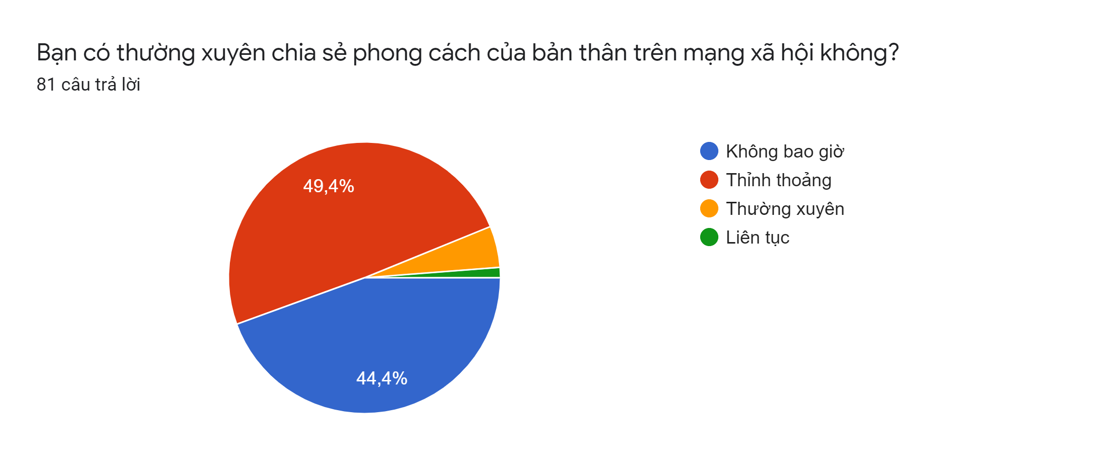
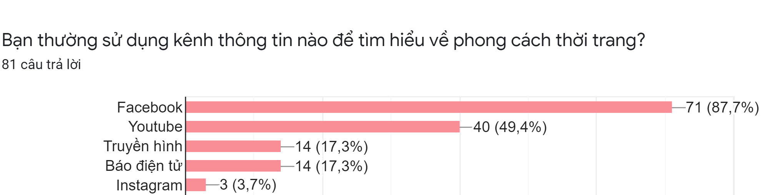

Slide 13
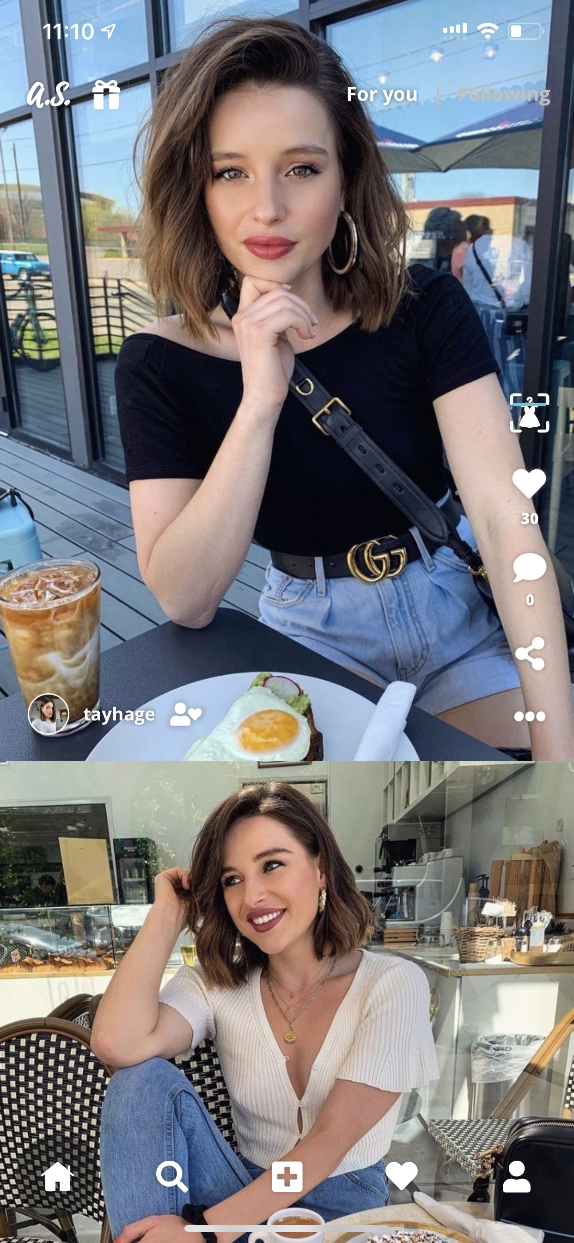
Existing
Dress AS
Strengths
Can search for similar products by image
Weaknesses
Just for women
Opportunities
The growing community of product enthusiasts
Threats
Simply an app to share images and search for related products, with little social network direction
Don’t allow write the caption for an image, don’t allow share post
Easy to share a personal image

Slide 14
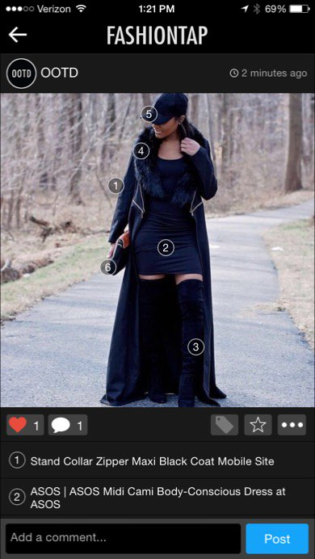
Existing
Fashion Tap
Strengths
Allows users to insert links on each item in the photo leading to the place of sale
Weaknesses
post content management difficulty
Opportunities
The growing community of product enthusiasts
Threats
Spamming, the more friends the user has, the more spammed will be the feed
Not yet support many languages

Slide 15

Proposal System
Build a social network for everybody. Help users share their fashion style and find suitable style for themselves.

Slide 16
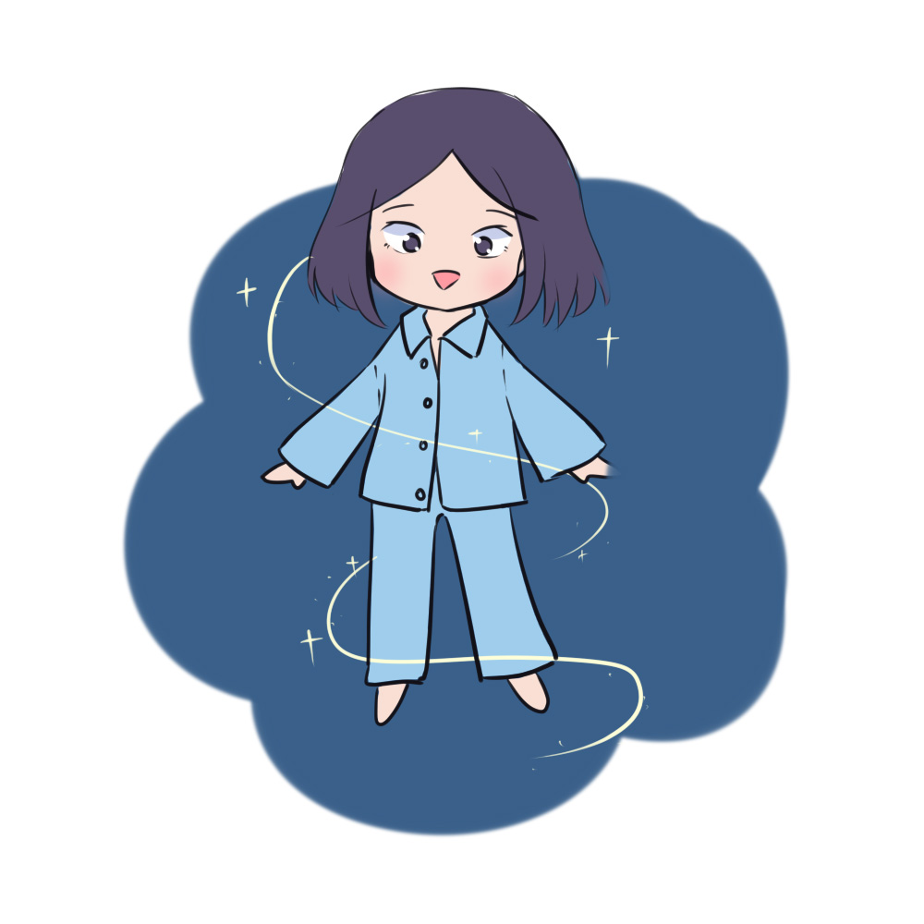
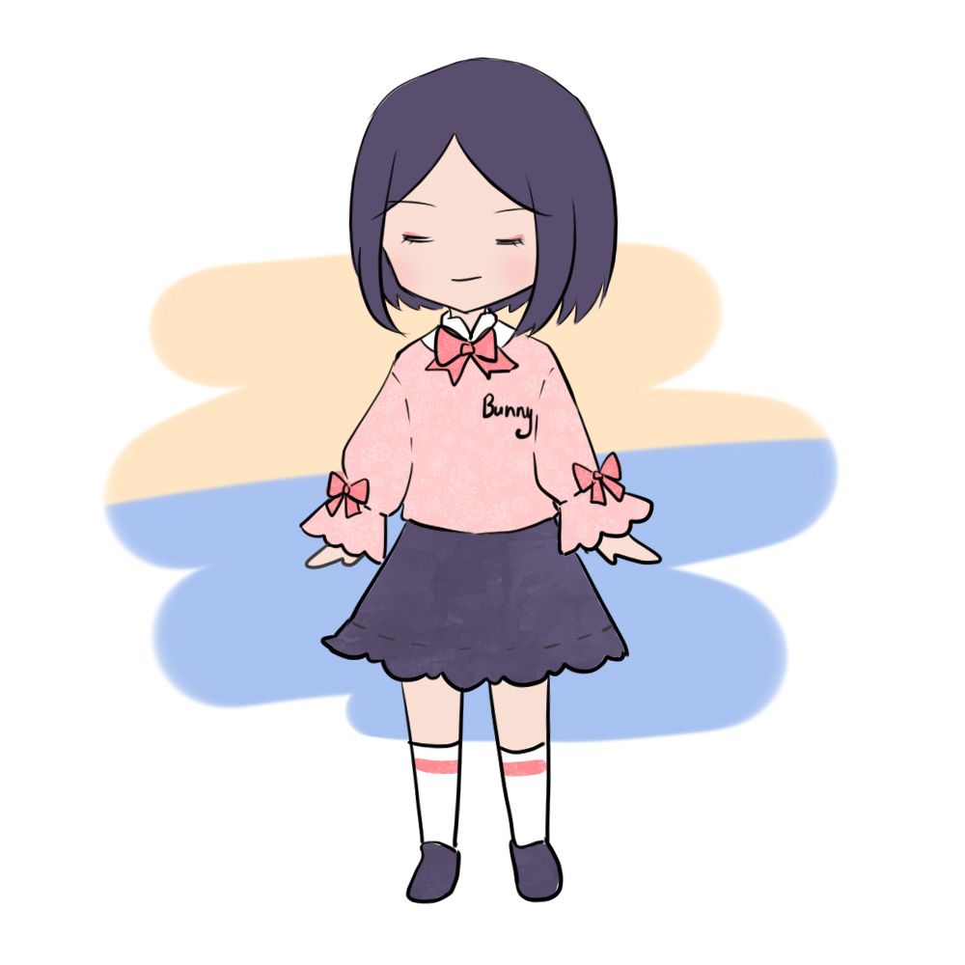
Role
User
System Manager
Users who use client app
Manager who use manager page

Slide 17
System function
View newsfeed (public article, hot article, recommend article)
React article (like, rate, comment, report)
Modify article (update, delete)
User interact (follow, report)
Chat with friend
Search sell place by image
Find suitable fashion
Manage balance and voucher
Manage notification
Search article or user by keyword
User
System Manager

Slide 18
System function
Manage user
Manage article
Manage report
Manage feedback
Manage support request
Manage voucher
Manage balance
Manage system statistics
User
System Manager

Slide 19
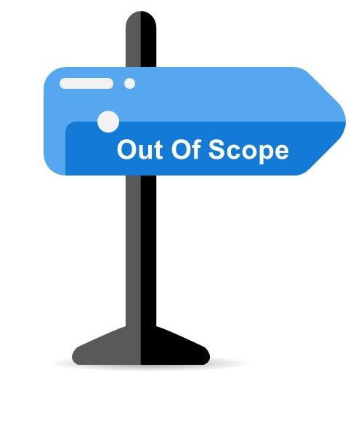
Out of scope funtion
Hide post, unhide post
Share post
Block user
Call voice & call video
Delete comment
Multiple languages
Product advertisement
Privacy setting

Slide 20
Tool and techniques
Category | Tools and techniques
Programming languages & runtime | C#, Python, Html, Css, JavaScript, TypeScript
Frameworks | ASP.Net core API, Angular 8, React Native
Software architecture | MVC
API | Clarifai, ZaloPay
Operating system | Windows 10, window server 2012
App environment | Android (Minimum version 5.0)
Deployment server | IIS Server (Server machine)
Version control | GitHub, Git 2.27.0
IDE/Editors | Visual Studio 2017
UML tools | Draw.io, Lucid chart, Microsoft office visio
DBMS | SQL Server Management System 2017
Project management tools | Trello
Process model | Agile Software Process Model
Communication tools | Facebook, Skype, google meet
Files management tools | Google Drive

Slide 21
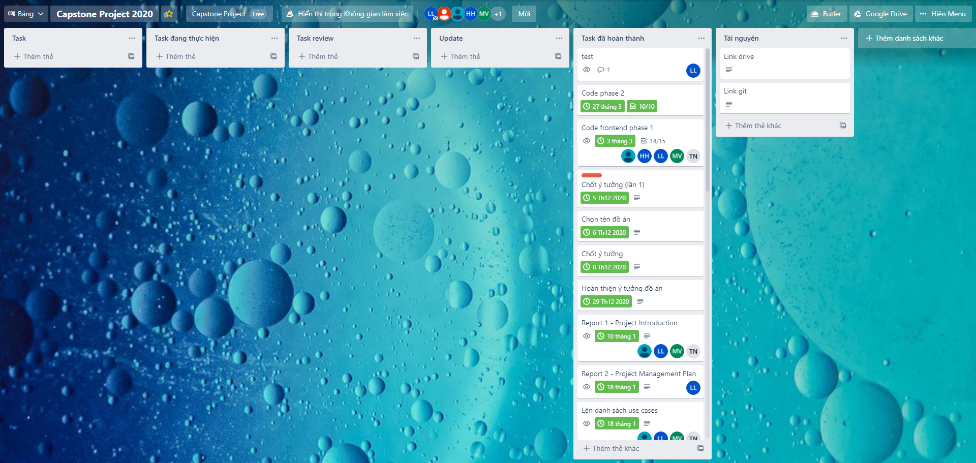
Management tool

Slide 22
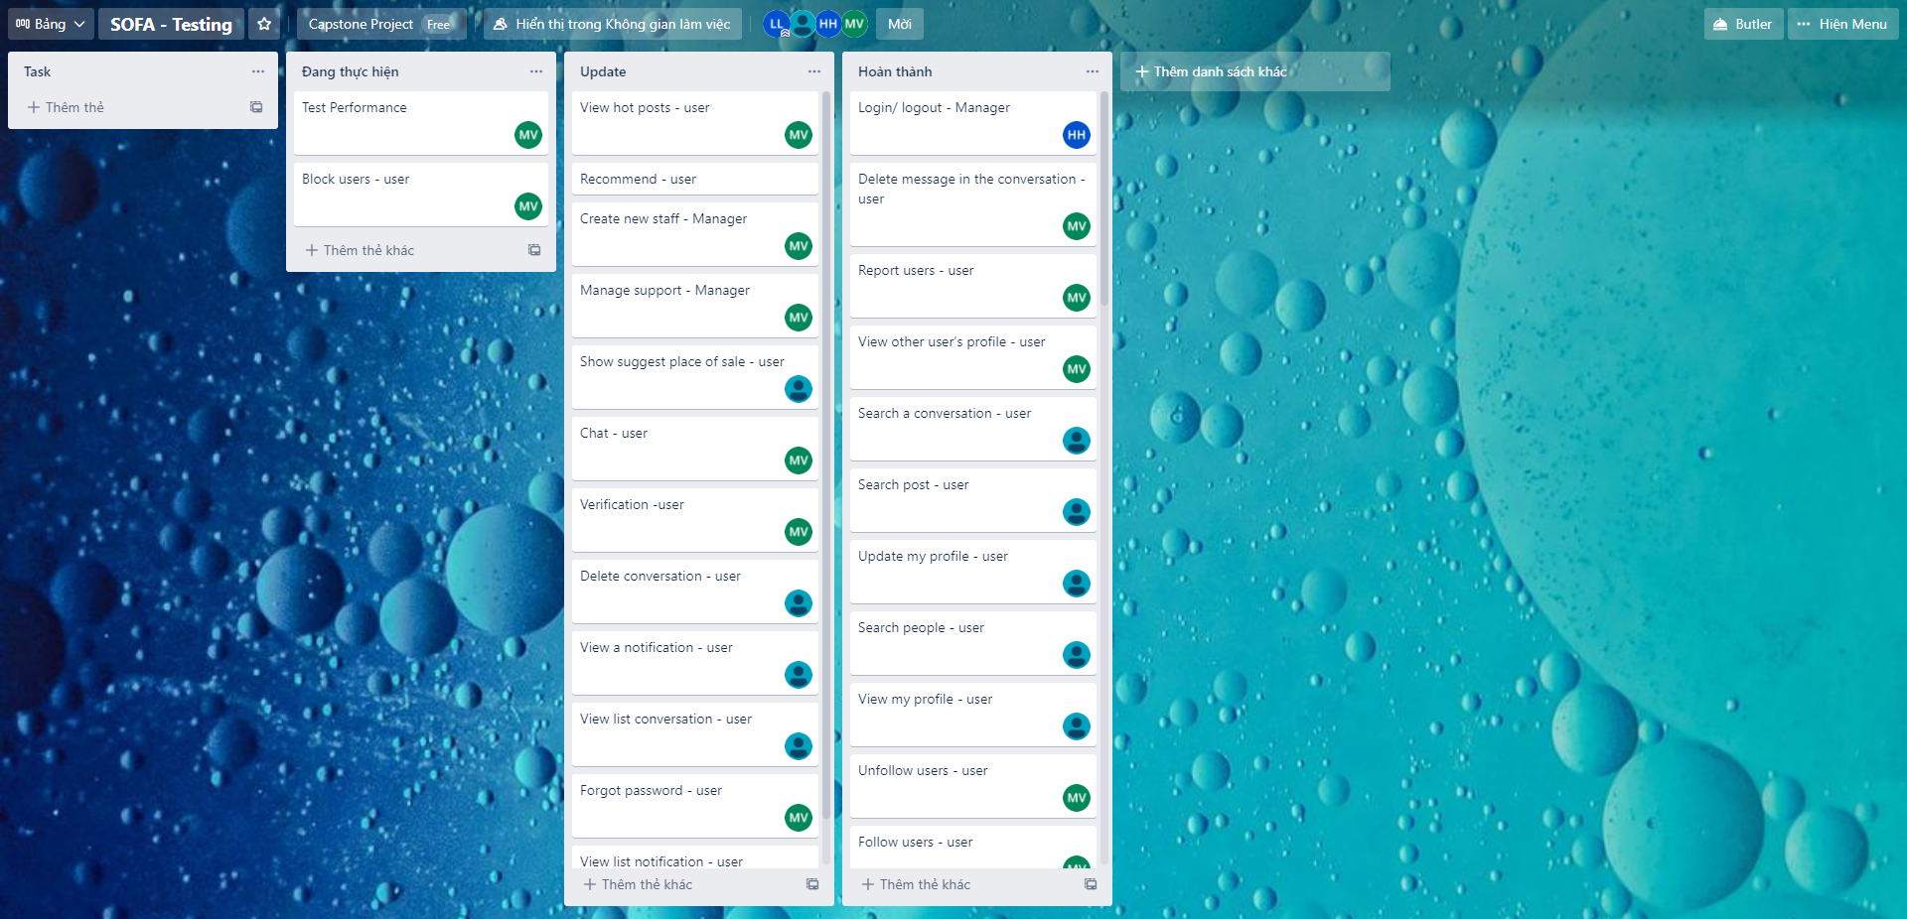
Management tool

Slide 23
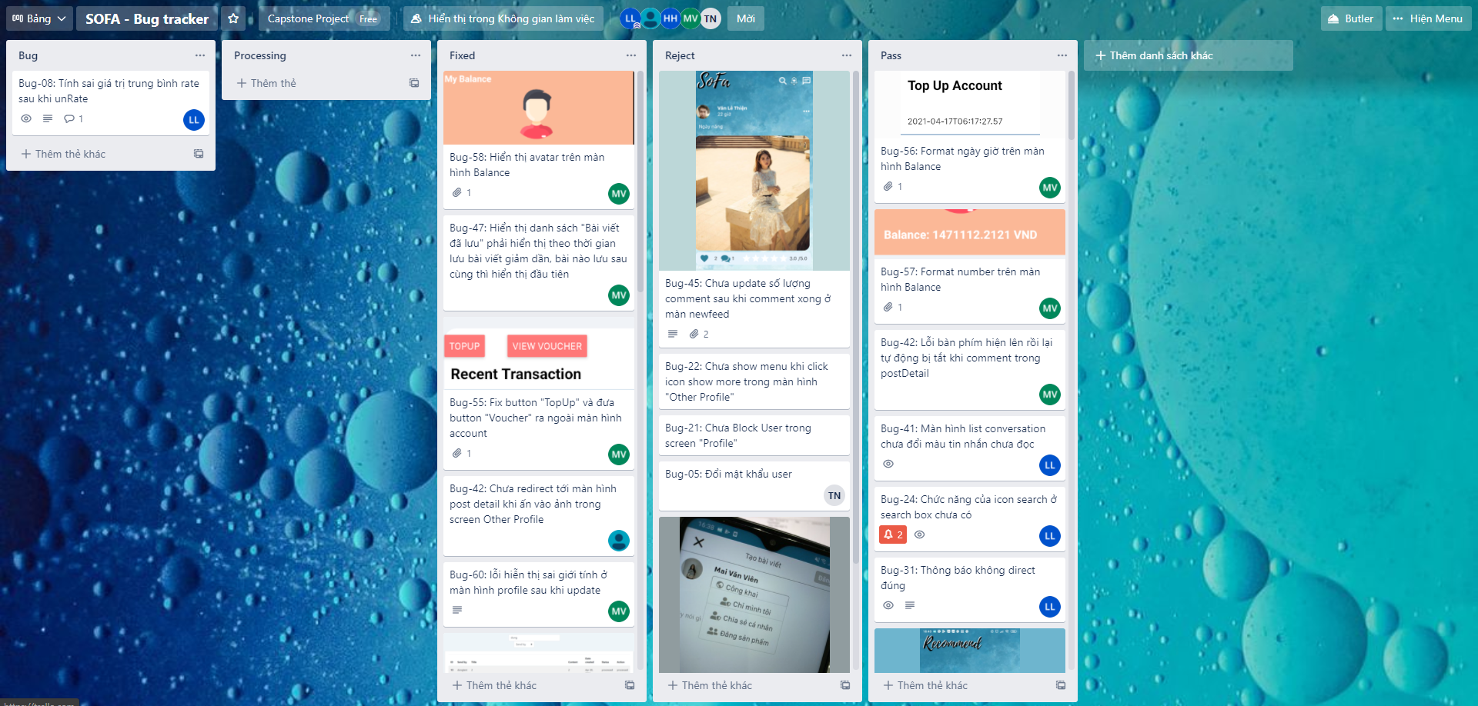
Management tool

Slide 24

02.
Project management plan

Slide 25
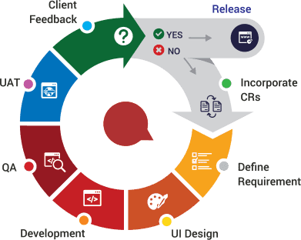
Software Process Model
Agile process model

Slide 26
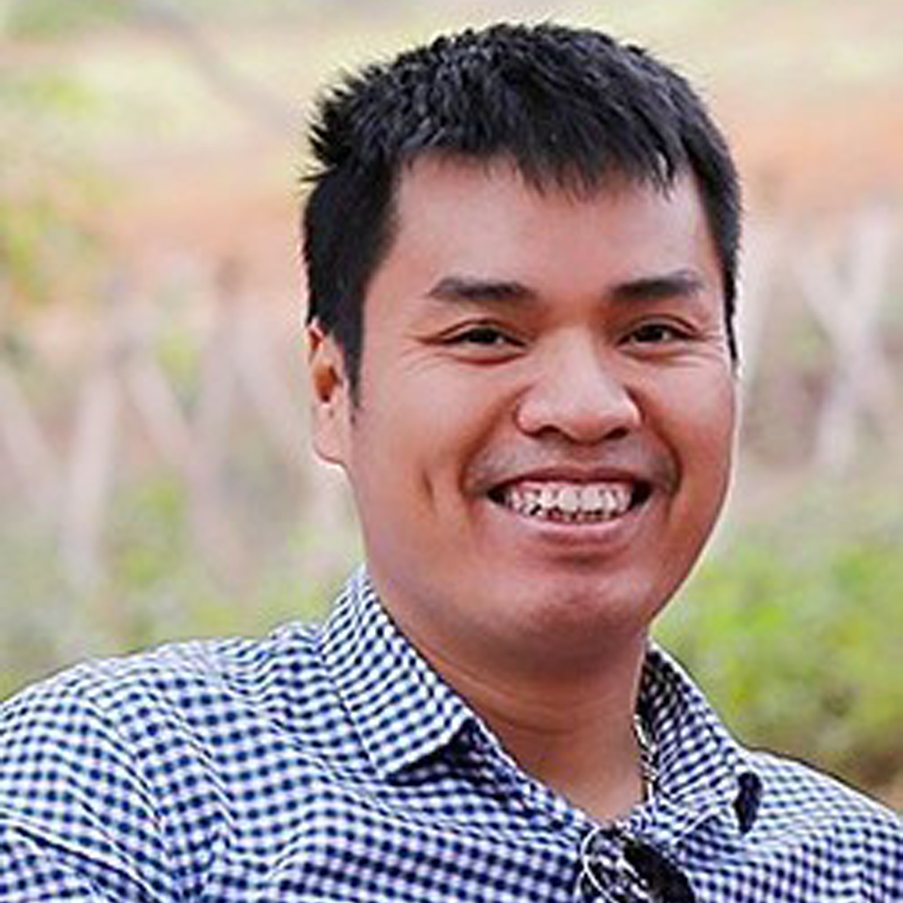
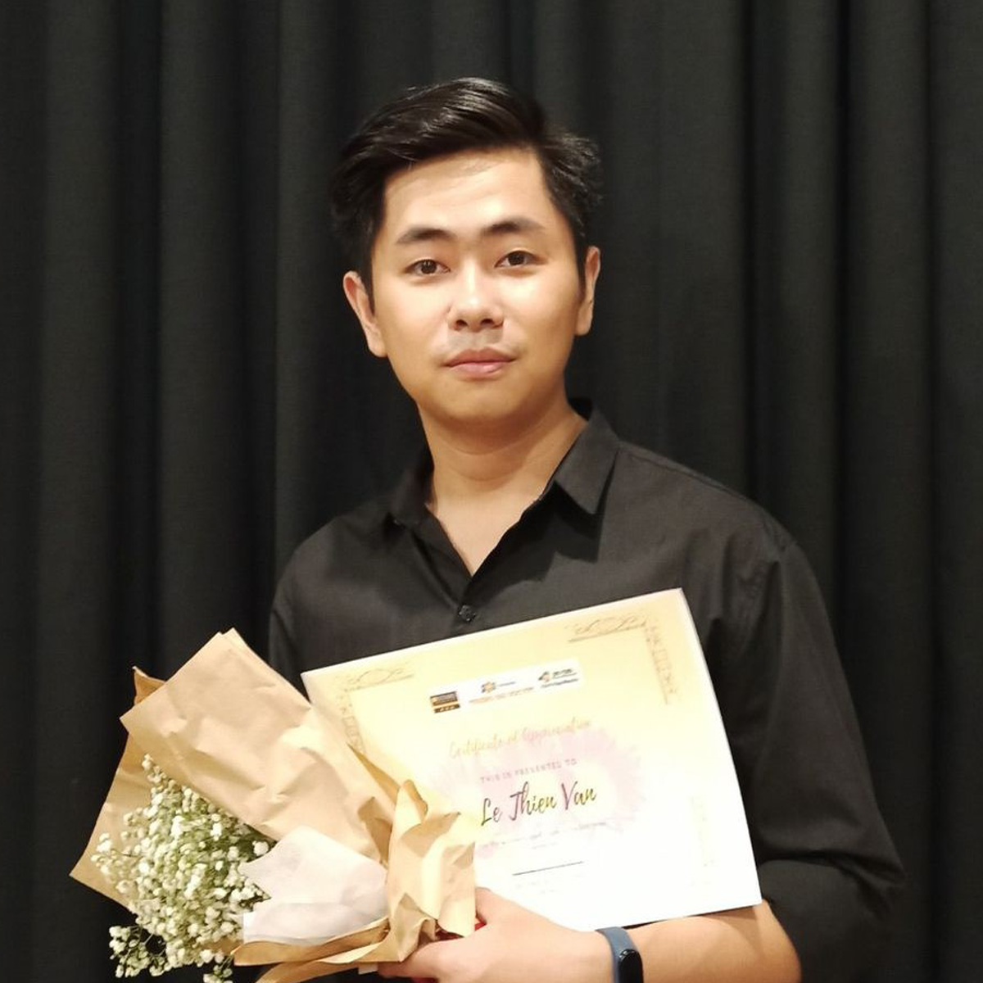
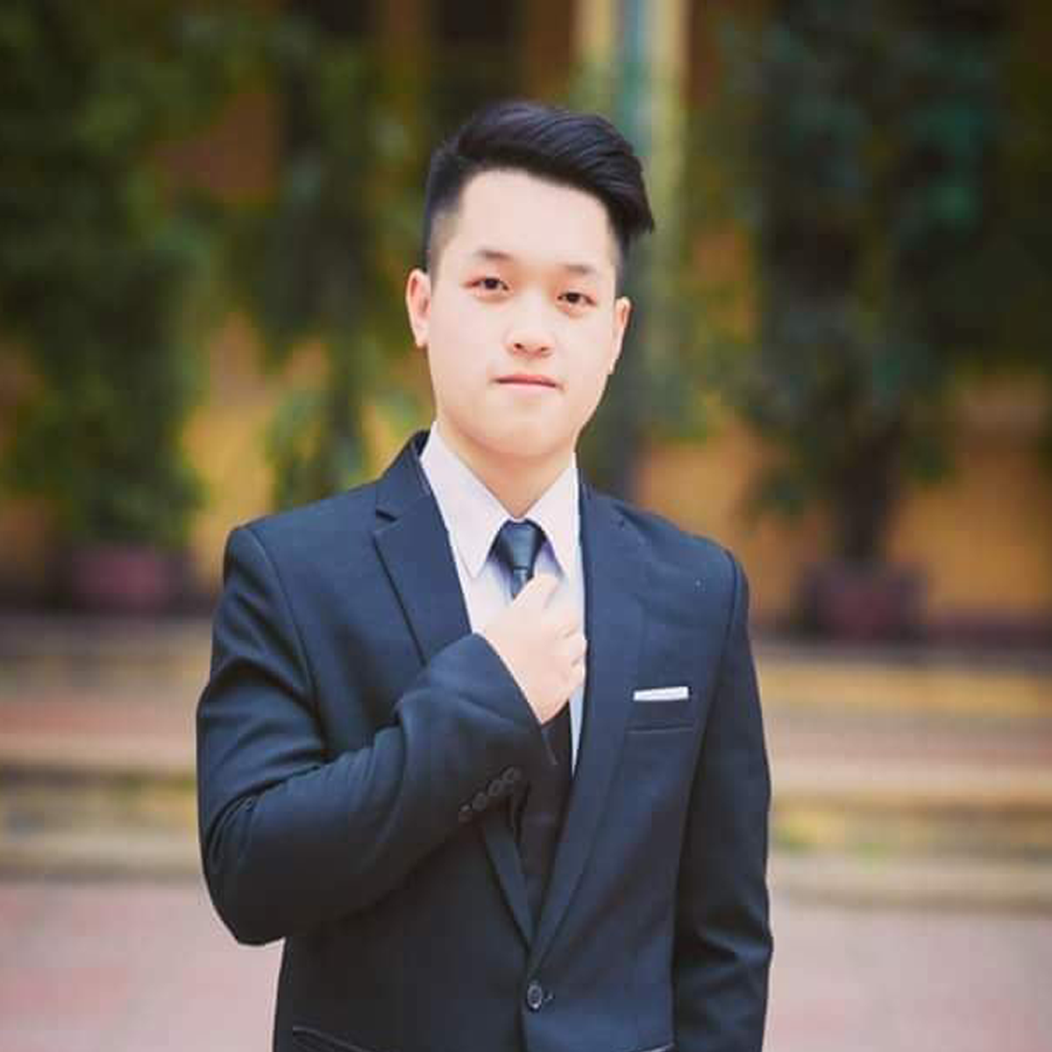
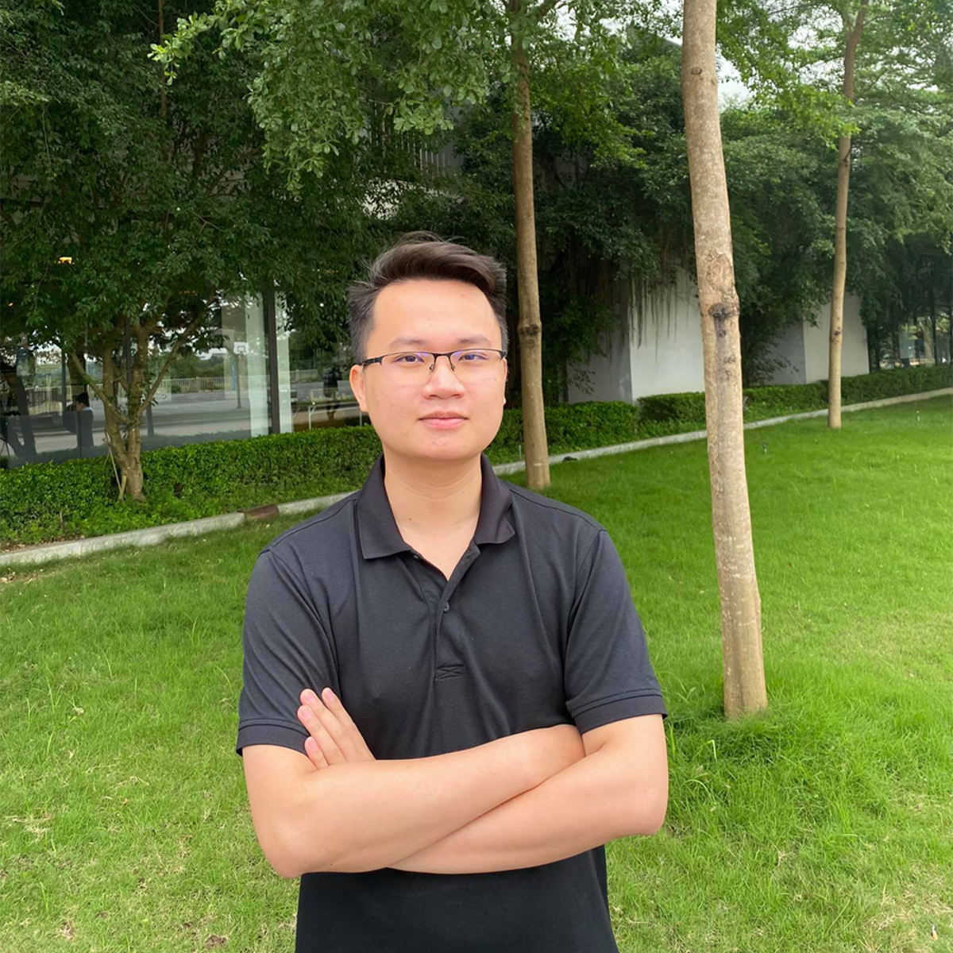
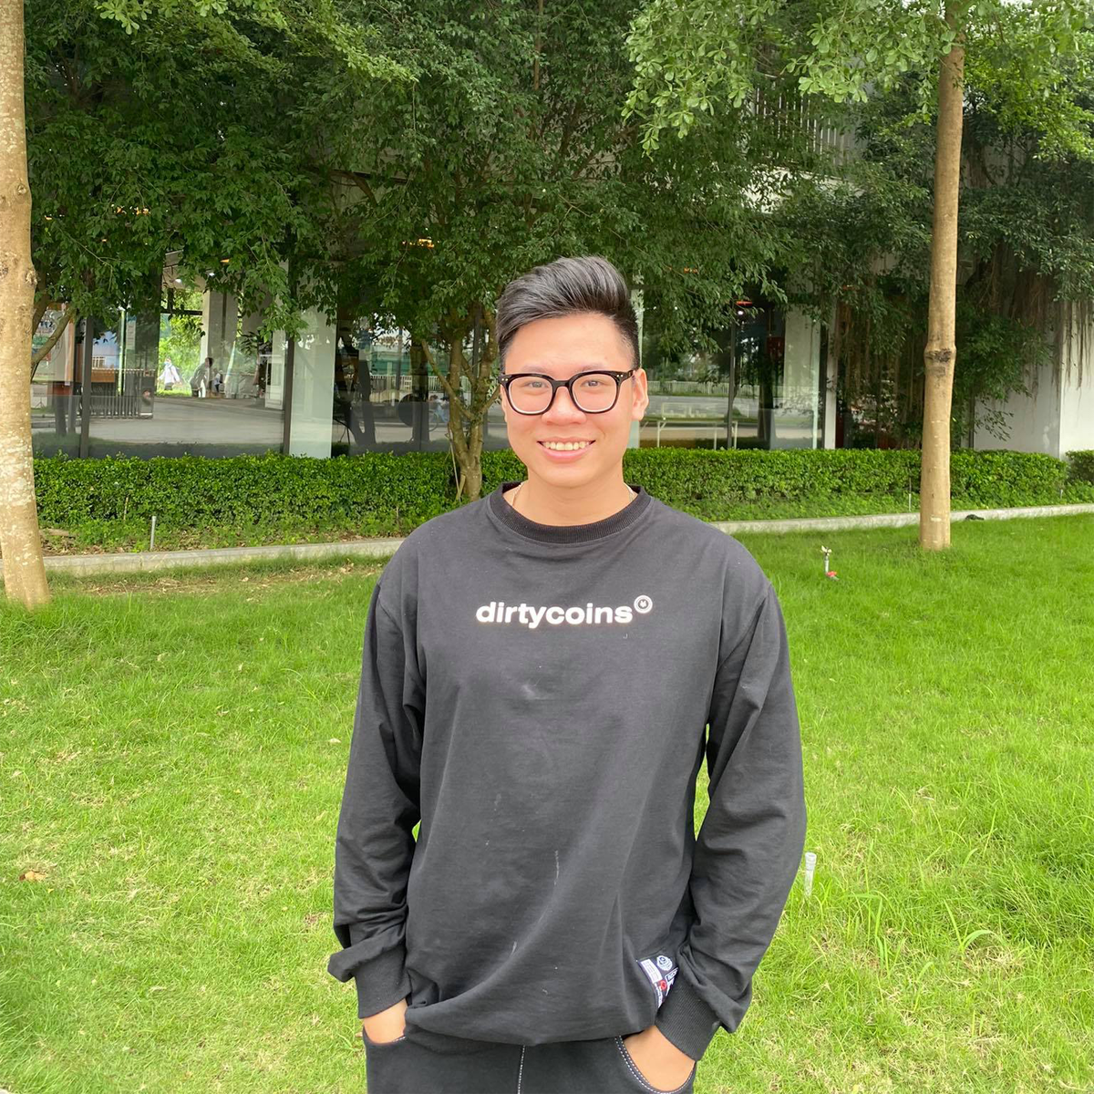
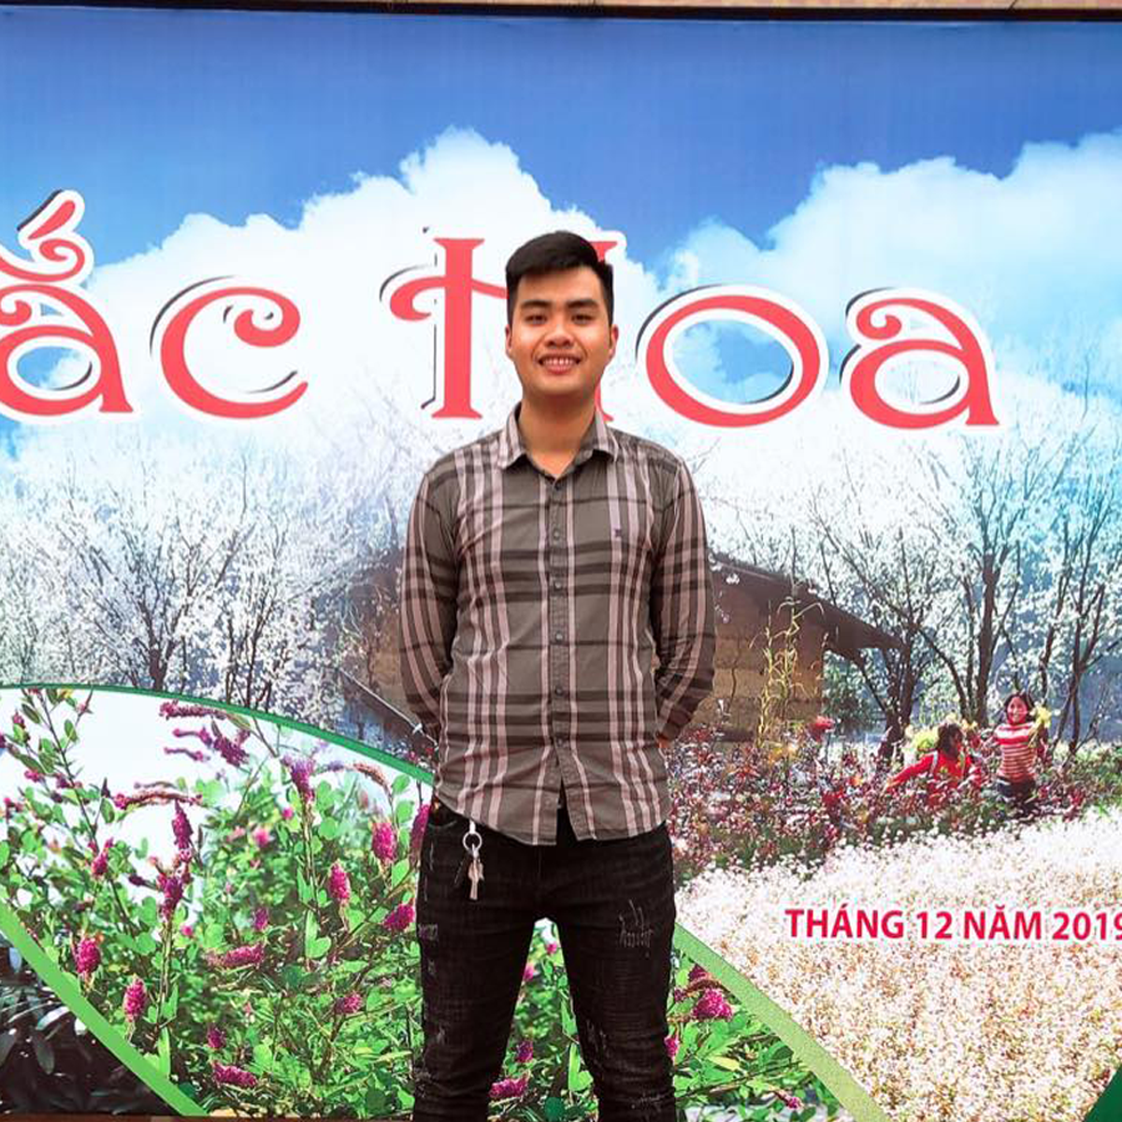
Phạm Ngọc Hà
Supervisor
Lê Thiện Văn
Project Manager
Nguyễn Huy Hoàng
Developer, tester
Nguyễn Thanh Tùng
Developer, tester
Hà Việt Dũng
Developer, tester
Mai Văn Viên
Developer, tester

Slide 27
Roles and Reponsibilities
Member | Detail Responsibilities
Lê Thiện Văn | Project Manager, technical leader, developer
Nguyễn Huy Hoàng | Analysis leader, developer, tester
Mai Văn Viên | Test Leader, developer, analysis member
Hà Việt Dũng | Designer, developer, tester
Nguyễn Thanh Tùng | Quality Assurance Manager, developer, analysis member

Slide 28



Teamwork
Meeting supervisor: once a week
Team meeting: once a week
Location: Room R107 / R313, Alpha Building, FPT University
Communication:

Slide 29
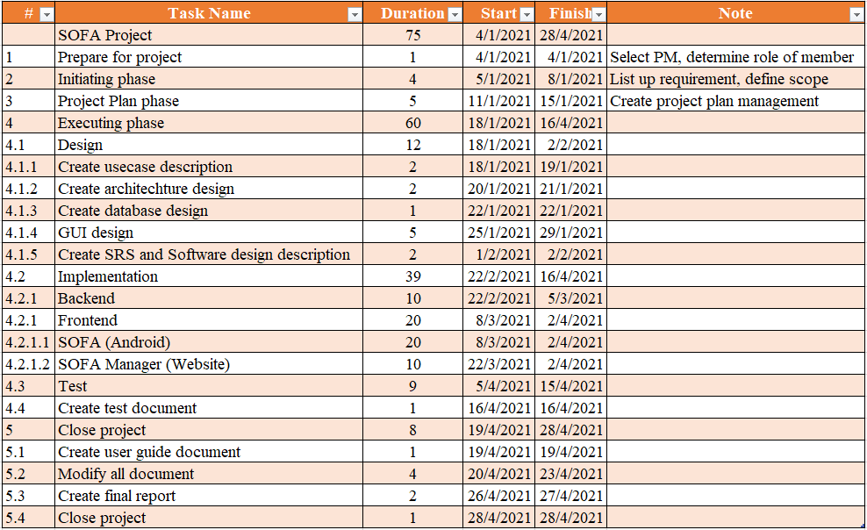
Prject Plan

Slide 30
Risk management plan
# | Risk | Description | Impact | Possibility | Response Plans
1 | Inaccurate Estimations | Schedule is inaccurate | Medium | Medium | 1) Create schedule carefully 2) Add backup time (or backup schedule) 3) Focus on close targets
2 | Poor Quality Code | The code may be difficult to read, meaning it is difficult for other developers to review or make changes | High | Low | 1) Code reviews 2) Clear coding standards and guides 3) Testing of all code
3 | Inadequate Human Resources | Don't have enough member to complete project be on time | Medium | Low | 1) Register overtime for team member
4 | Technical Difficulties | Have issues during coding | Medium | Medium | 1) Choose design pattern appropriate 2) Create architecture design more detail and exactly 3) Have a professional in team
5 | Security | The system is unsafe for user, hacker can attack and take user information… | High | High | 1) Using token for improving backend security 2) Add more algorithm for hash private information 3) Take preventive measures hacking
6 | Serious error in synchronization between web and mobile platform | display on browser and mobile is more difference. Maybe, the component just can use on web but not mobile | Medium | High | 1) Choose another component to fix 2) Make components difference but similar feature
7 | lack of requirement | Developer create code was not enough requirement | High | Medium | 1) Code reviews 2) Clear coding standards and guides 3) Testing of all code

Slide 31
03.
Software Requirement Specification

Slide 32
Software Requirement Specification
Software requirement specification
Functional requirement
Non-functional requirement
Entity diagram

Slide 33

3.1
Software requirement specification

Slide 34

SYSTEM ACTORS
GUEST
USER
MANAGER
The person who does’t have an account and not log in to the system
The person who has an account and logged in
The person who manages the whole system, users, posts, reports, balance and recommendation data

Slide 35
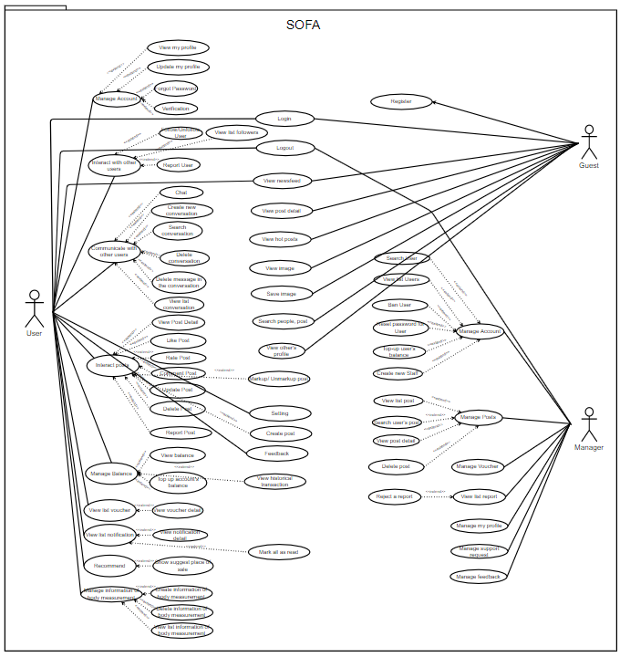
System Usecase Diagram

Slide 36
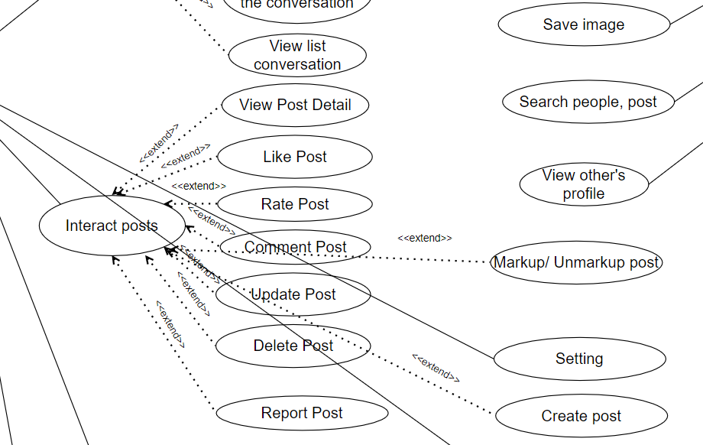
System Usecase Diagram
System Usecase Diagram

Slide 37

3.2
Functional Requirement

Slide 38
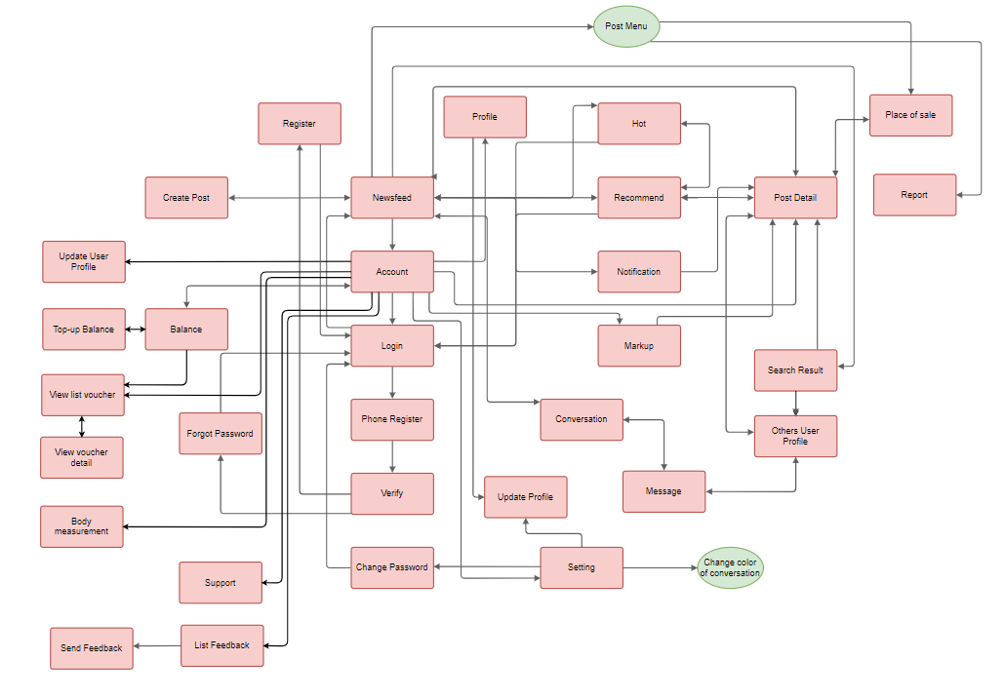
Screen Flow (User)

Slide 39
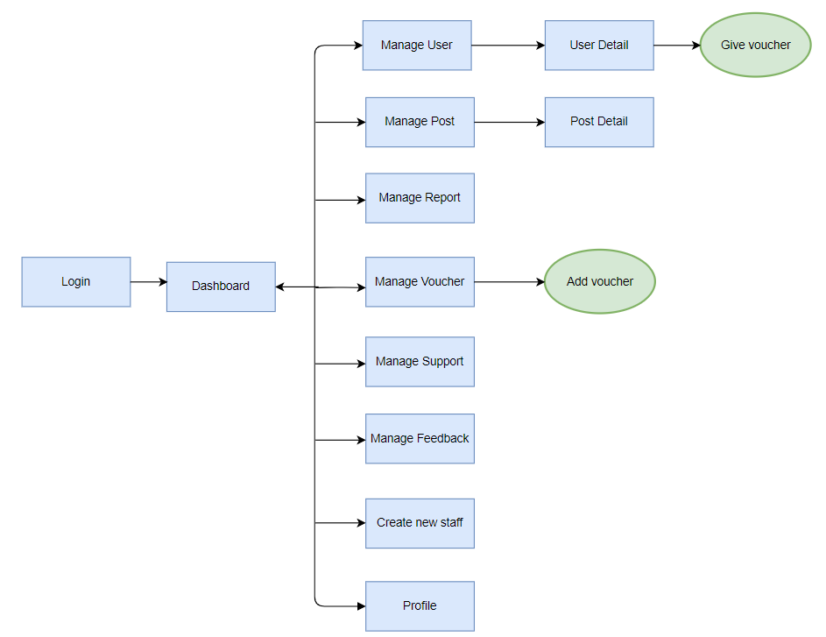
Screen Flow (Manager)

Slide 40

3.2
Non-functional Requirement

Slide 41
Non-functional Requirement
Usability
Peformance
Maintainability
Reliability
Security

Slide 42
Non-functional Requirement
Usability
Peformance
Maintainability
Reliability
Security

Slide 43

Usability
- The application has a stylish interface with the ocean blue main color - The system has a friendly and good-looking GUI - The interface of main functions is inherited and developed from previous successful systems such as Facebook, Instagram, ...

Slide 44
Non-functional Requirement
Usability
Peformance
Maintainability
Reliability
Security

Slide 45
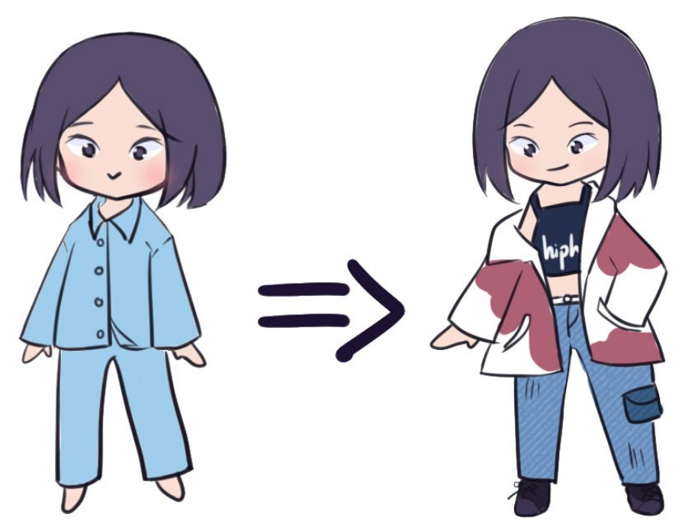
Reliability
GUEST
2
3
1
The system complies with business rules
The application is guaranteed to run smoothly, without errors, stable and safe
The display of personal information such as email, phone number, measurements, ... will be private

Slide 46
Non-functional Requirement
Usability
Peformance
Maintainability
Reliability
Security

Slide 47

GUIDING PRINCIPLES
- Two functions (Message and Notification) are real-time updates. When a new message or notification appears, users will receive it immediately
- The system allows 10000 users at a time

Slide 48
Non-functional Requirement
Usability
Peformance
Maintainability
Reliability
Security

Slide 49

Security
- Each email, phone number is only validated for one account. Users can use a Google account to log in
- The system must use HTTPS to encrypt the information transferred between clients and servers.
- Use the JWT Bearer Token to authenticate users
- Before uploading a file to the system, the file will be verified for the correct file format

Slide 50
Non-functional Requirement
Usability
Peformance
Maintainability
Reliability
Security

Slide 51

Maintainability
- We can easily maintain our application because of the separation of concern - At the same time, we can split many developers' work at a time. It will not affect one developer's work to another developer's work.

Slide 52
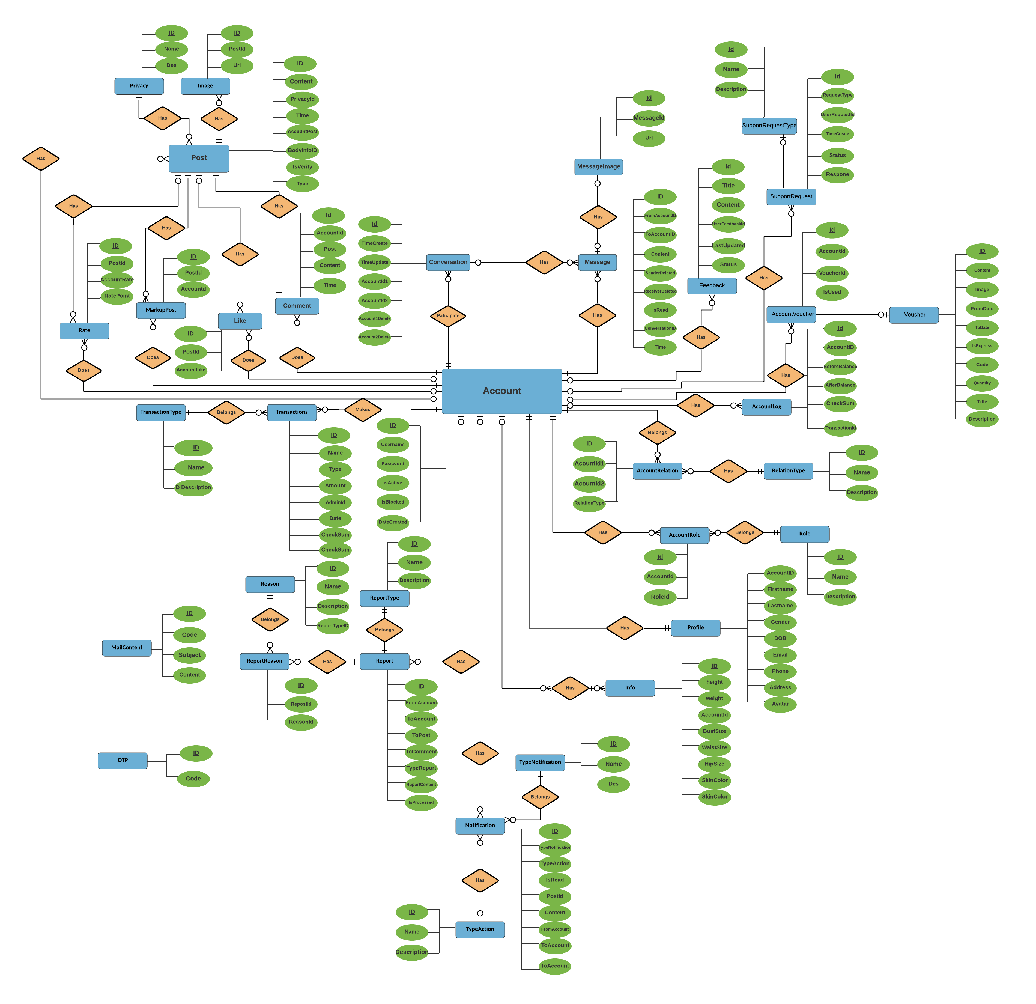
Entity relation diagram

Slide 53
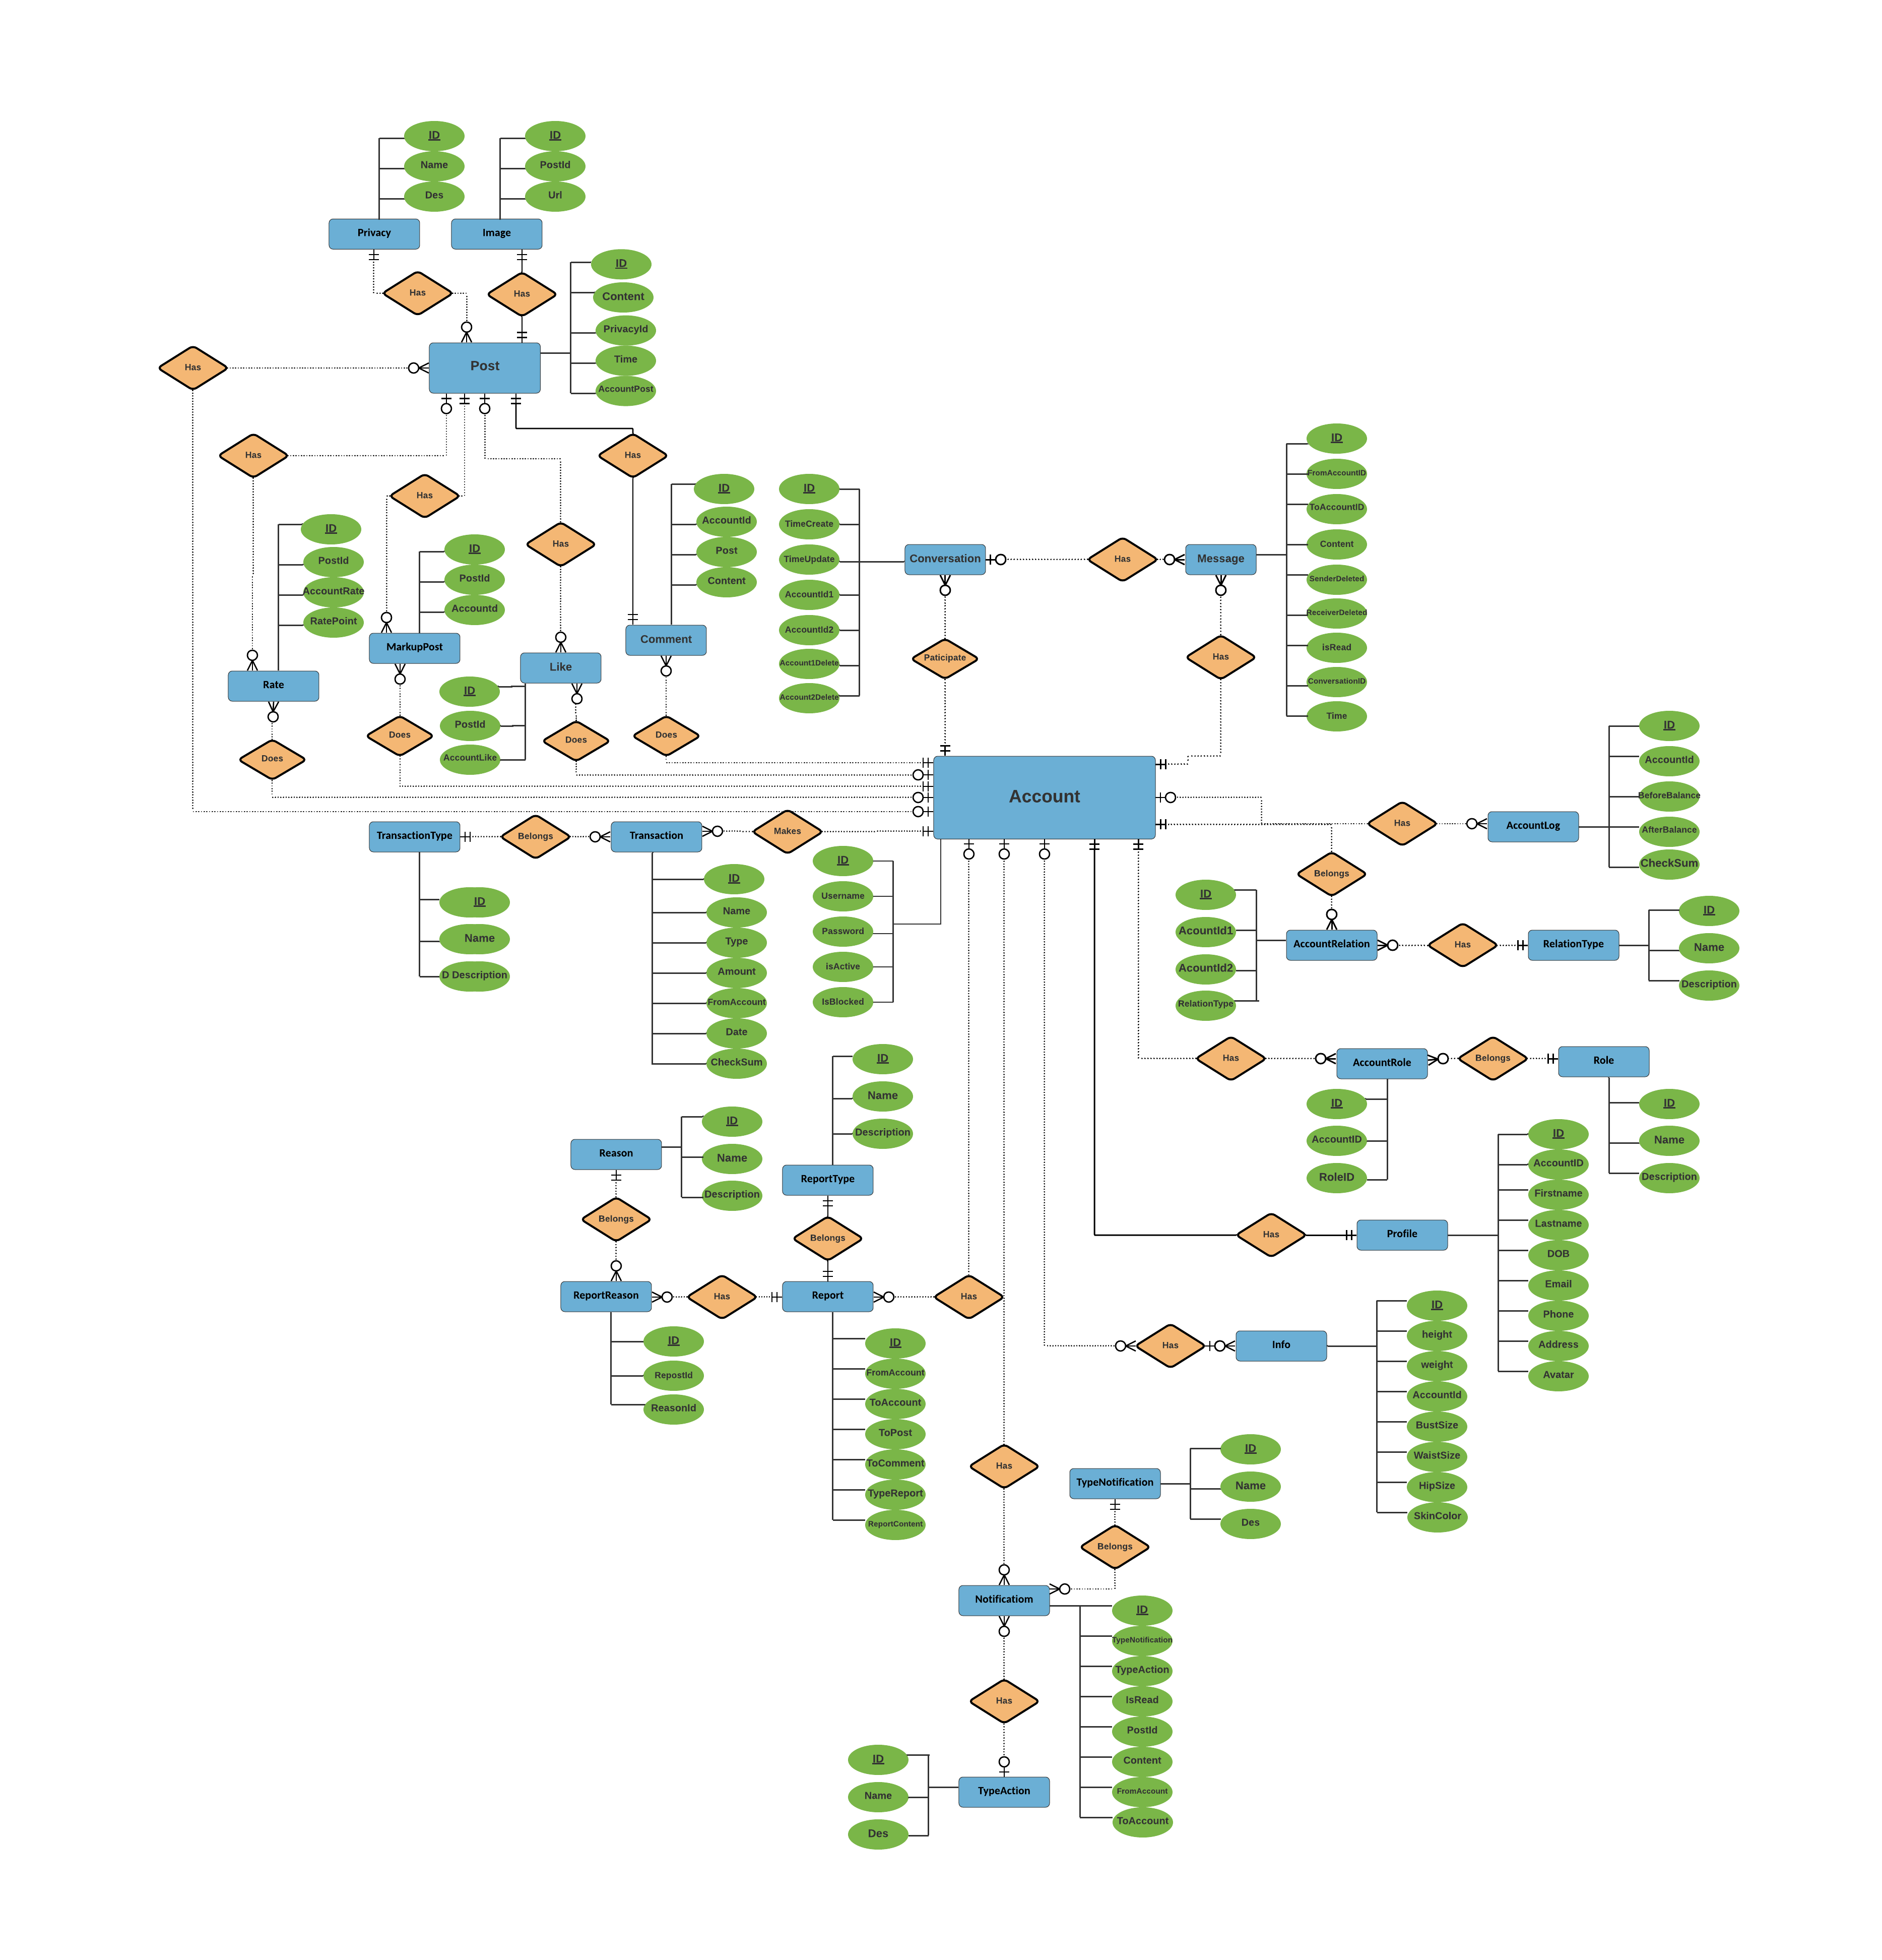
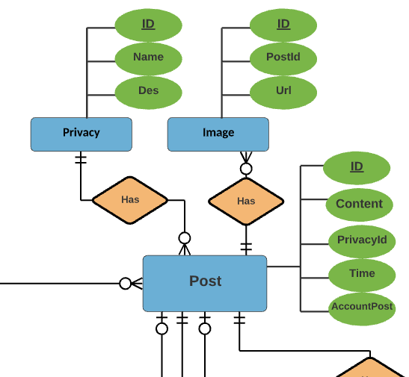
Entity relation diagram
Entity relation diagram

Slide 54
04.
Software Design

Slide 55
Software Design
1
2
3
4
System Architecture Design
Software Architecture Design
Component Diagram
Class Diagram
5
6
7
Sequence Diagram
Description of System Interface
User Interface Design

Slide 56
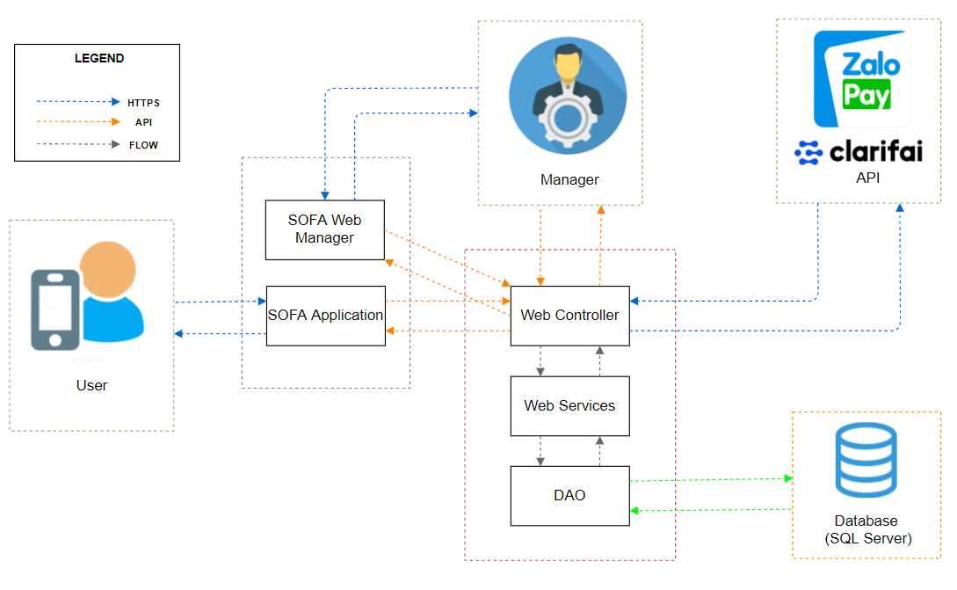
System Architecture Design

Slide 57
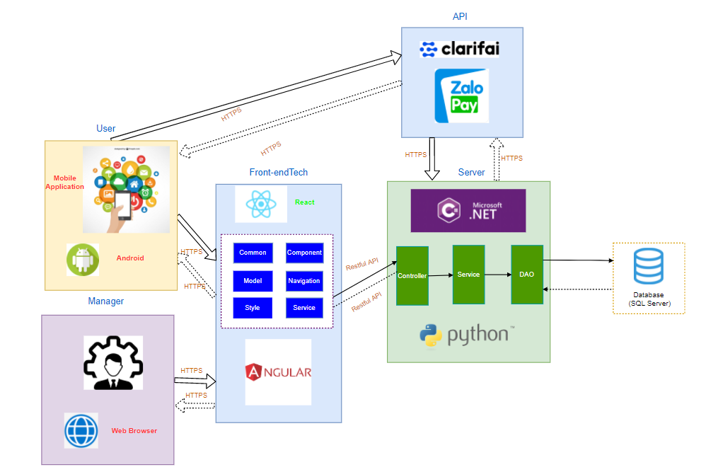
Software Architecture Design

Slide 58

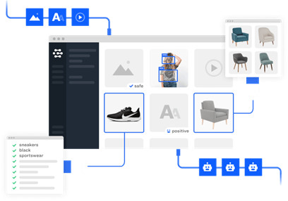
System Interface

Slide 59
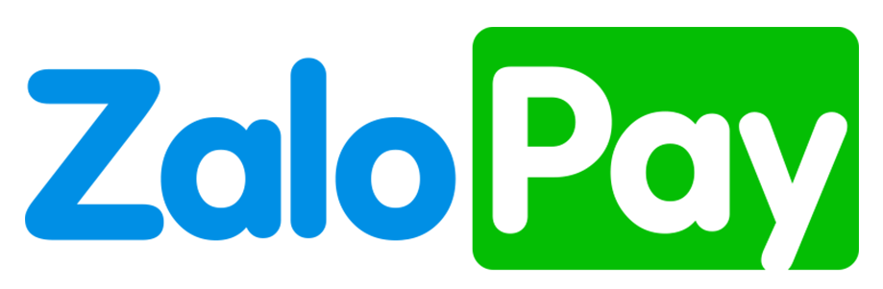
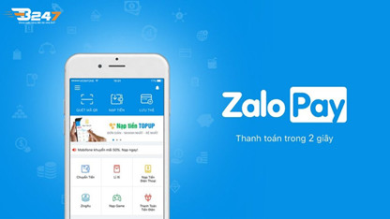
System Interface

Slide 60

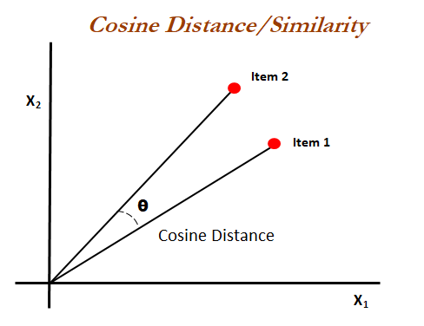
System Interface

Slide 61
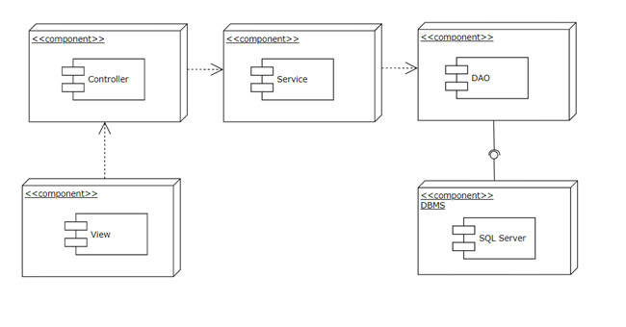
Component Diagram

Slide 62
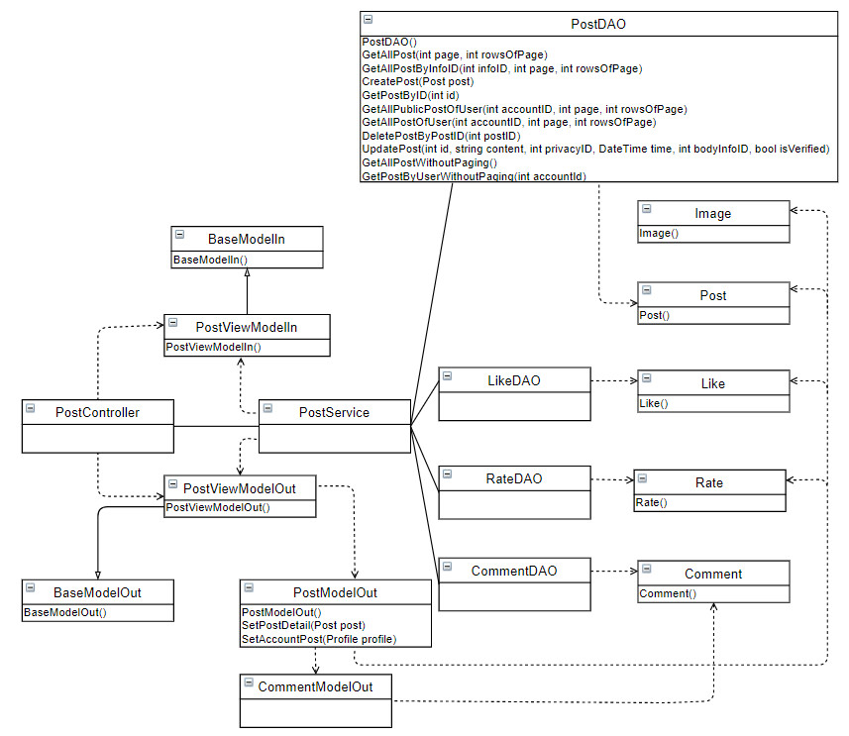
Class Diagram
Post class diagram

Slide 63
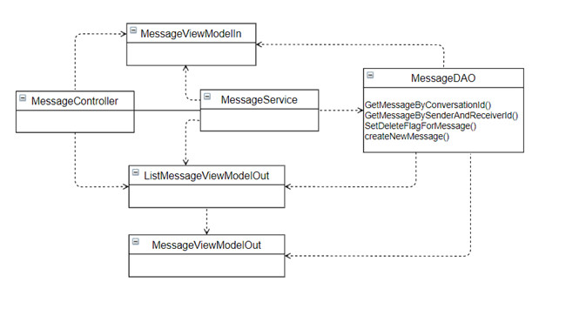
Class Diagram
Message class diagram

Slide 64
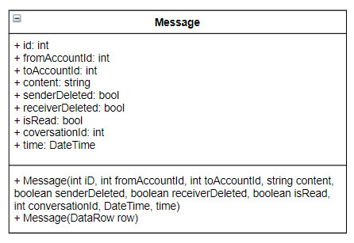
Class Diagram
Message model

Slide 65
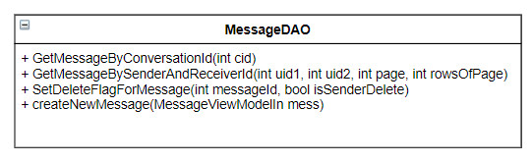
Class Diagram
Message DAO

Slide 66
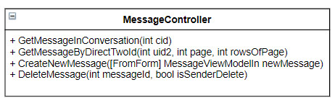
Class Diagram
Message Controller

Slide 67
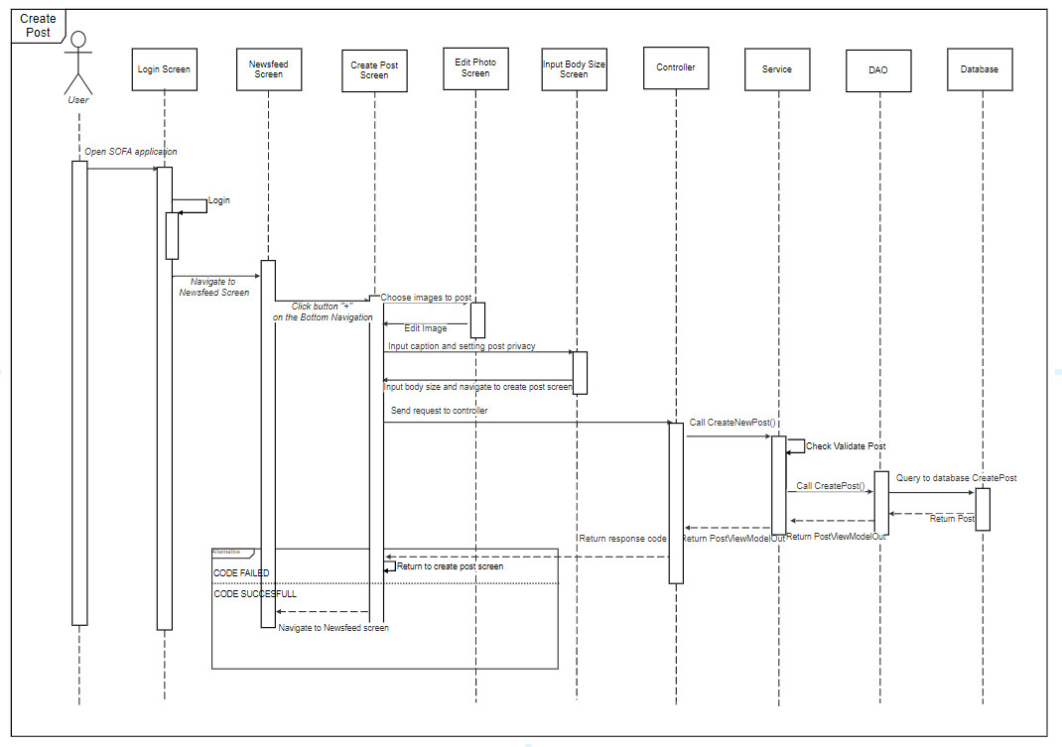
Sequence Diagram

Slide 68
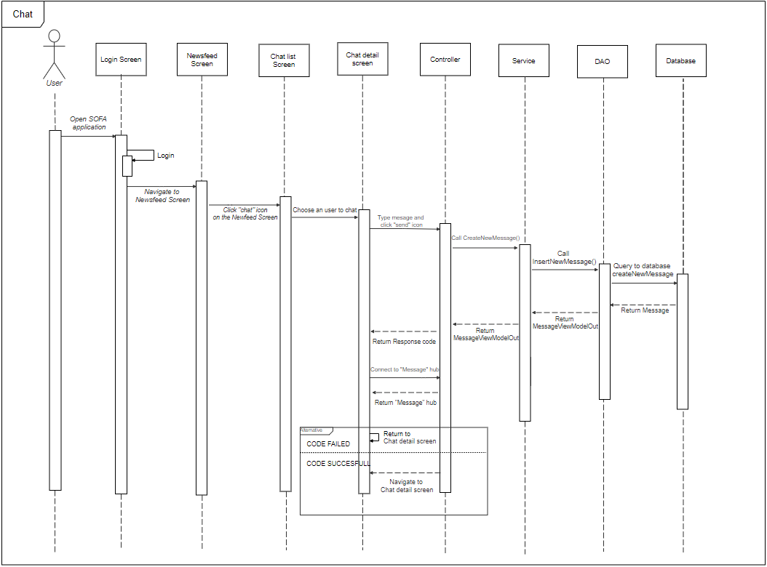
Sequence Diagram

Slide 69
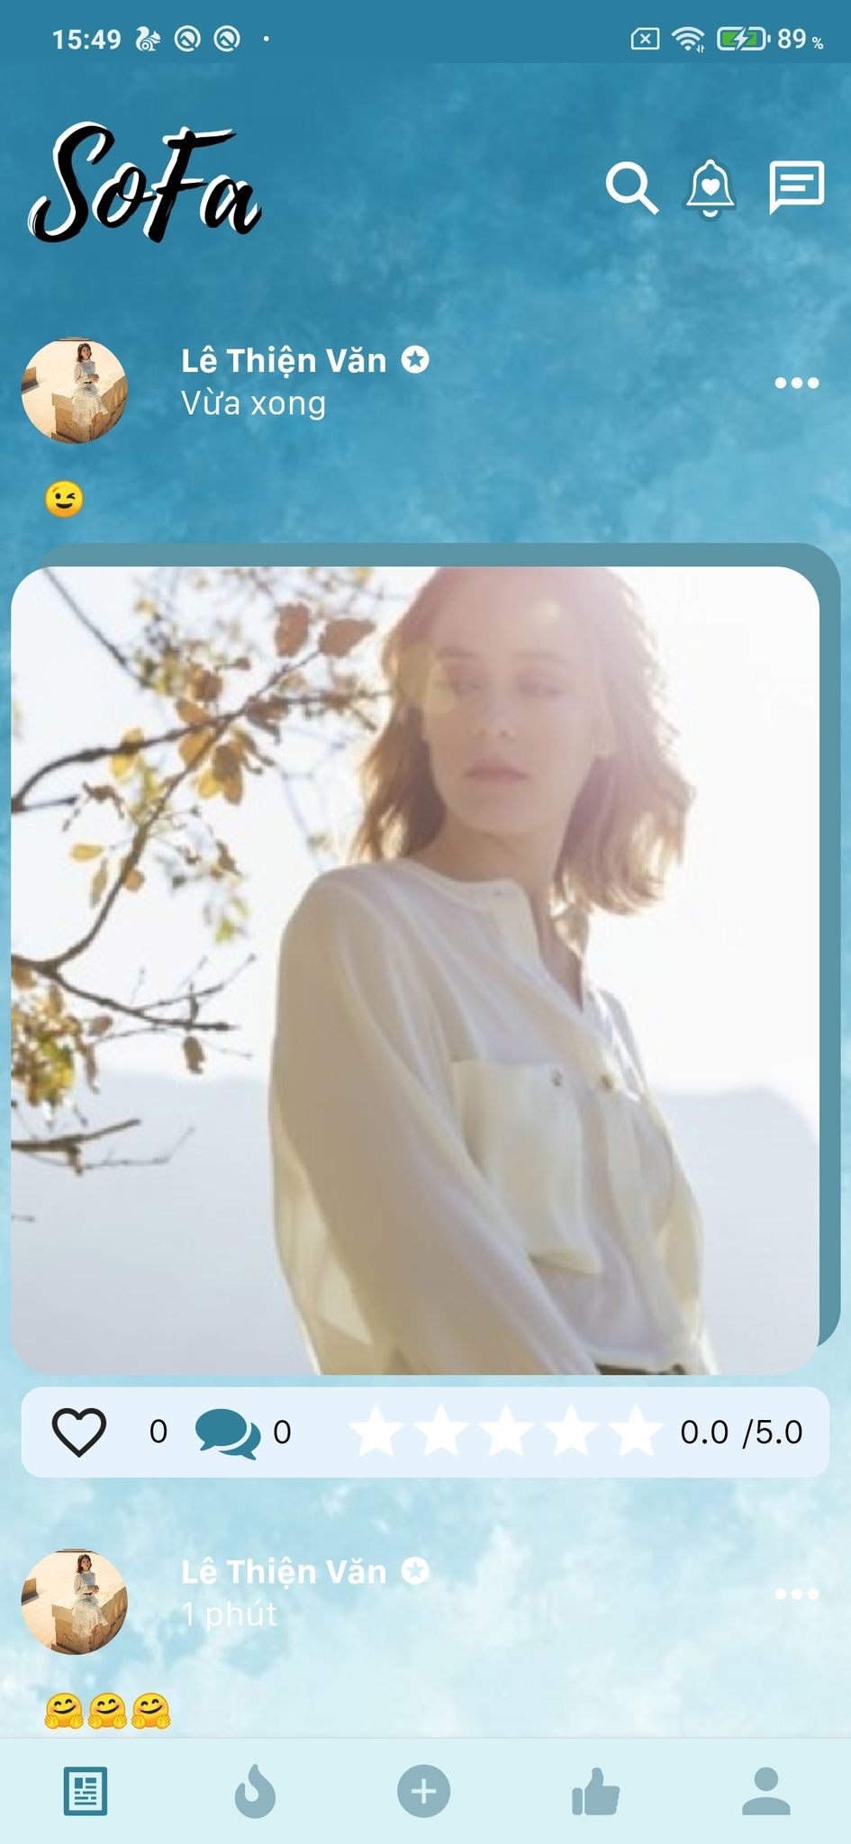
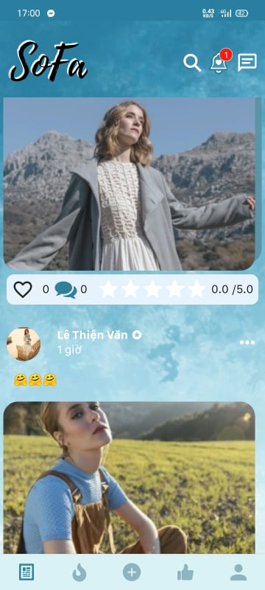
User Interface Design
Newfeed Screen

Slide 70
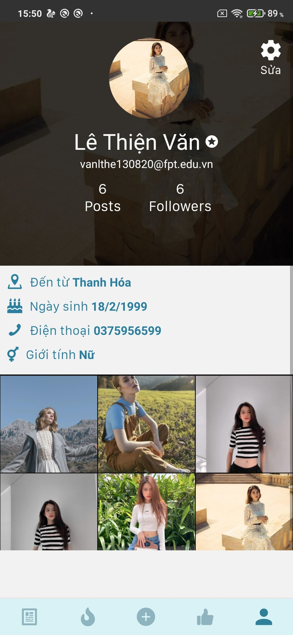
Profile Screen
User Interface Design

Slide 71

Search Screen

Slide 72

Chat Screen
User Interface Design

Slide 73

Manager – Login screen

Slide 74

Manager – Post list screen

Slide 75

Manager – User detail screen

Slide 76

Database Design

Slide 77

Entity relation diagram
Entity relation diagram

Slide 78
05 Testing

Slide 79

Testing Model
V- model

Slide 80
Testing Stages
Unit Testing
Integration Testing
System Testing
Acceptance Testing

Slide 81
Testing Type
Type of test | Stage of test
 | Unit testing | Integration testing | System testing | Acceptance testing
Unit test | ✔ | ✔ | ✔
GUI test |  |  | ✔ | ✔
Function test | ✔ | ✔ | ✔ | ✔
Acceptance test |  |  |  | ✔

Slide 82
Testing Process
Test Plan
Test Design
Test Execution
Exit Criteria
Test Reporting

Slide 83

Unit Test

Slide 84

Integration Test

Slide 85

Acceptance Test
Acceptance Test

Slide 86


Performance Test

Slide 87

Bug Tracker

Slide 88

Thanks!
Does anyone have any questions?
youremail@freepik.com +91 620 421 838 yourcompany.com

